Slide 1

Credit Card Fraud Detection
Named: Passant Adel Farouq

Slide 2

Analyzing Fraudulent Activities
Using
Anomaly Detection

Slide 3


Business Understanding

Slide 4
Workflow
Data Understanding
Data Preprocessing
Model Training
overSampling
Model Evaluation

Slide 5
Data Understanding
Dataset Overview:
Number of records: 284 807
Features: 31
Class Distribution:
Non-Fraud - (284315) 99.8%
Fraud - (492) 0.17%

Slide 6
Methodology
Standard scaling for 'Amount' and 'Time'.
Models Employed:
Decision Tree.
Random Forest.
Logistic Regression.
Sampling Technique:
SMOTE for handling class imbalance.

Slide 7
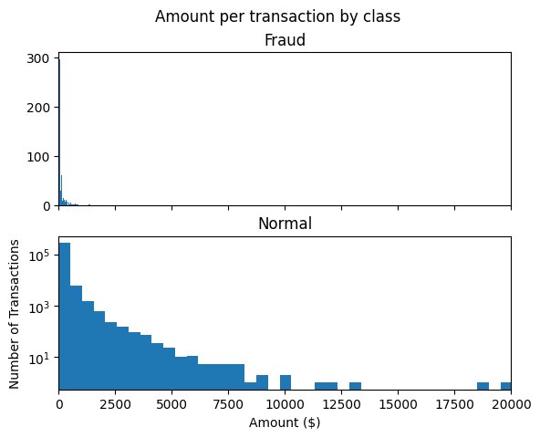
EDA Charts
Transaction
Amount Distribution:

Slide 8
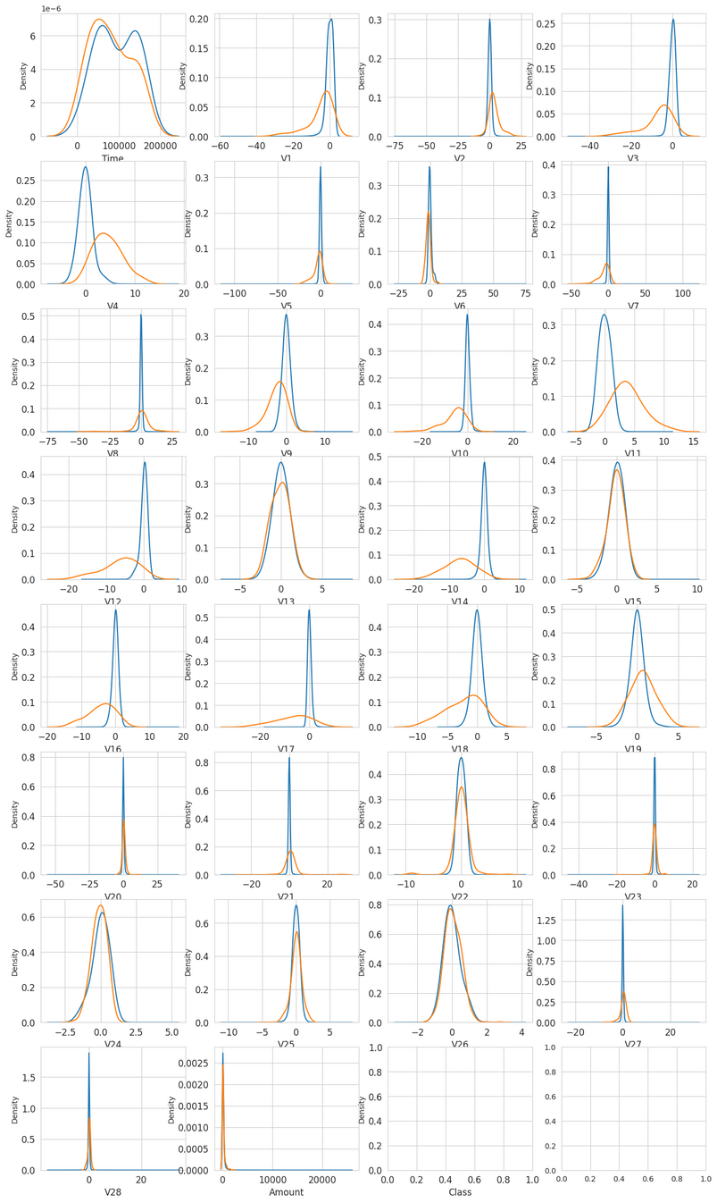
EDA Charts
Normal vs Fraud
Distribution

Slide 9
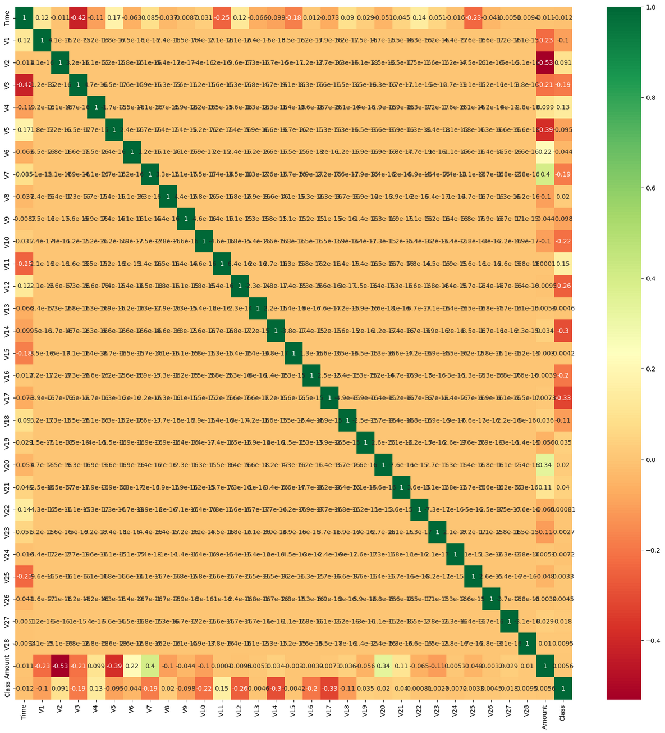
EDA Charts
Correlation Matrix

Slide 10
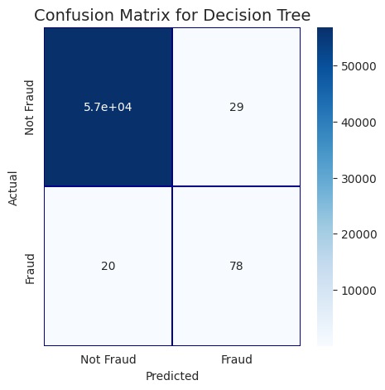
Model Evaluation
Decision Tree
Confusion Matrix:
Evaluation Metrics:
Accuracy: 99.9%
Precision: 68.1%
Recall: 79.5%
F1 Score:76%
ROC AUC:89.77%

Slide 11

Model Evaluation
Random Forest
Confusion Matrix:
Evaluation Metrics:
Accuracy: 99.9%
Precision: 97.4%
Recall: 77.5%
F1 Score:86.3%
ROC AUC:88.7%

Slide 12
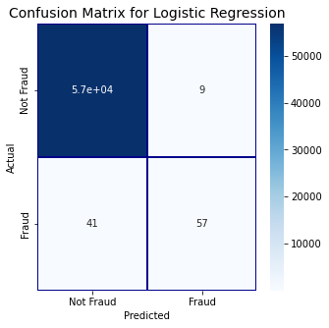
Model Evaluation
Logistic Regression
Confusion Matrix:
Evaluation Metrics:
Accuracy: 99.9%
Precision: 86%
Recall: 58%
F1 Score:69.5%
ROC AUC:79%

Slide 13
Oversampling
Oversample the minority class
The Synthetic Minority Oversampling Technique (SMOTE)
Data augmentation for the minority class.
Resampled our data

Slide 14
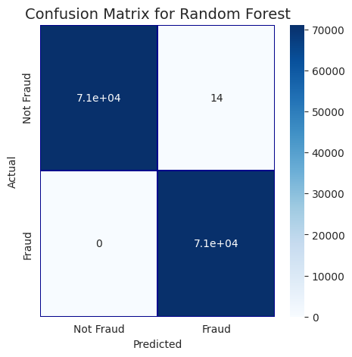
Model Selection
Random Forest
Confusion Matrix:
Evaluation Metrics:
Accuracy: 99.9%
Precision: 99.9%
Recall: 100%
F1 Score:99.9%
ROC AUC:99.99%

